Slide 1
Rocket league rank predictor
Pasquale De Marinis

Slide 2

Business Understanding
Rocket League
Multiplayer Online Game
Hybrid soccer-car game
Soccer game, but with cars instead of humans
Competitive
Ranking system

Slide 3

Rocket League Competitive Ranks
22 Ranks
Player is classified into a rank after playing 10 matches in competitive
Ranks are a discretization of an «invisible» number called Match Making Rating (MMR)

Slide 4
Rocket League Competitive Ranks
At the first match
MMR = 600
He wins: MMR += G
He loses: MMR -= G
G is 150 at the first match
Decreases after each match until 10 after a dozen of matches

Slide 5
Rocket League Competitive Ranks
Player converges into their appropriate rank
Plays with same skill lever players
Relatively slow convergence (20-30 matches)
G is only determined by match outcome and not by player skills shown in the match

Slide 6
Business Understanding Determine Business Objectives
Need for a more fast and fair ranking system
The system should be capable of determining the player rank analyzing the performances shown during the match
Business Success Criteria:
Positive feedback by the community after its implementation
Increase in daily active players
Prediction should be computed within 0.5 second on the game servers

Slide 7
Business Understanding Determine Data Mining Goals
High level goal: prediction
Task: regression
dependent variable is the MMR
Success criteria:
Mean Absolut Error < 2.0
Root Mean Squared Error < 2.5
Inference time < 0.5 seconds on CPU AMD Ryzen 2600x

Slide 8

Data Understanding Collect Initial Data
ballchasing.com
Collects replays from players and provide statistics about
Replay: large binary file containing information about each instant in the game (each player, ball position, direction, speed etc.)
Ballchasing API used to collect replay statistics
Collection process:
For each rank
Sampled a date-hour range in the last year
Get all replays in that range
Until N replays are retrieved

Slide 9
Data Understanding Collect Initial Data
From each replay 6 rows are extracted
Each match has 6 players
Problems:
«Low» ranks are underrepresented
Less replayes founds
Unbalanced data
To upload replays, user needs the ballchasing plugin
Low ranks players tendentially doesn’t now or are not interested

Slide 10
Data Understanding Describe Data
404951 rows
84 columns
1 categorical nominal feature
MVP
24 numeric discrete features
saves | goals_against_while_last_defender | count_powerslide | amount_overfill_stolen
assists | shots | amount_collected_small | amount_collected
goals | inflicted | amount_collected_big | amount_stolen
taken | shots_against | amount_stolen_small | amount_stolen_big
count_collected_big | count_collected_small | amount_overfill | amount_used_while_supersonic
count_stolen_big | count_stolen_small | score | goals_against

Slide 11
Data Understanding Describe Data
59 continuous features
percent_closest_to_ball | time_offensive_half | percent_boost_50_75 | percent_boost_speed
avg_speed_percentage | percent_boost_25_50 | time_high_air | percent_supersonic_speed
bcpm | percent_farthest_from_ball | time_defensive_third | time_neutral_third
avg_distance_to_mates | percent_high_air | avg_amount | percent_most_forward
percent_slow_speed | time_behind_ball | time_slow_speed | avg_distance_to_ball_no_possession
time_supersonic_speed | percent_offensive_half | percent_neutral_third | total_distance
percent_full_boost | time_zero_boost | time_closest_to_ball | time_low_air
percent_ground | shooting_percentage | percent_boost_0_25 | avg_distance_to_ball
time_full_boost | time_boost_50_75 | time_infront_ball | time_boost_25_50
avg_speed | percent_behind_ball | percent_boost_75_100 | time_boost_speed
percent_zero_boost | avg_powerslide_duration | time_boost_0_25 | time_boost_75_100
goals_against | percent_defensive_half | percent_most_back | time_ground
time_most_back | percent_defensive_third | bpm | time_powerslide
time_farthest_from_ball | percent_low_air | avg_distance_to_ball_possession | time_defensive_half
time_offensive_third

Slide 12
Data Understanding Verify data quality
Accurate: data cannot be subject to human errors, due to its generation process.
It is possible to do a consistency check on counts and percentages and times
> 0
< 100 for percentages
All rows passed this checks

Slide 13
Data Understanding Verify data quality
Incomplete: some rows have missing values in the following columns:
percent_closest_to_ball,
percent_farthest_from_ball,
percent_most_forward,
avg_distance_to_mates, time_most_back
Can be due to leaving the match before the end, or connections errors during the match

Slide 14
Data Understanding Verify data quality
Up-to-date:
Data refers to a single match
Data is calculated from the replay file.
After the replay is built it can’t be updated
Thus, data can’t be outdated

Slide 15
Data Preparation Clean Data
Anticipated step, with missing values, data can’t be explorated
199 rows contained missing data
Most simple approach chosen: remove those rows

Slide 16
Data Understanding Verify data quality
Consistent - Measures:
Distances : unreal units (= centimeters)
Speeds: uu/s
Measures units are consistent for all the features

Slide 17
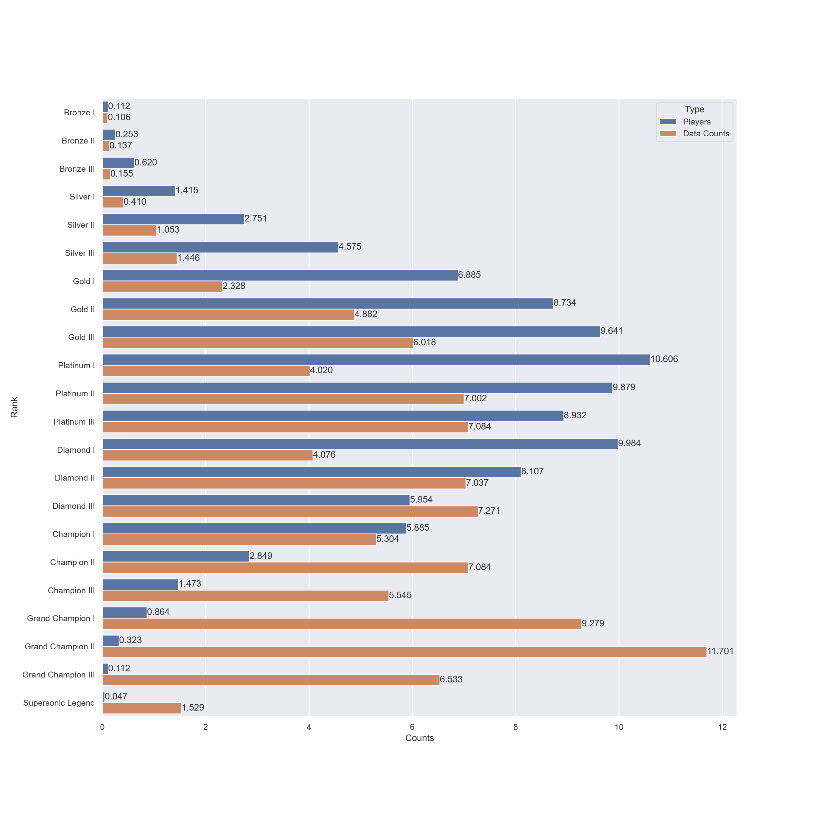
Data Understanding Data Exploration

Slide 18
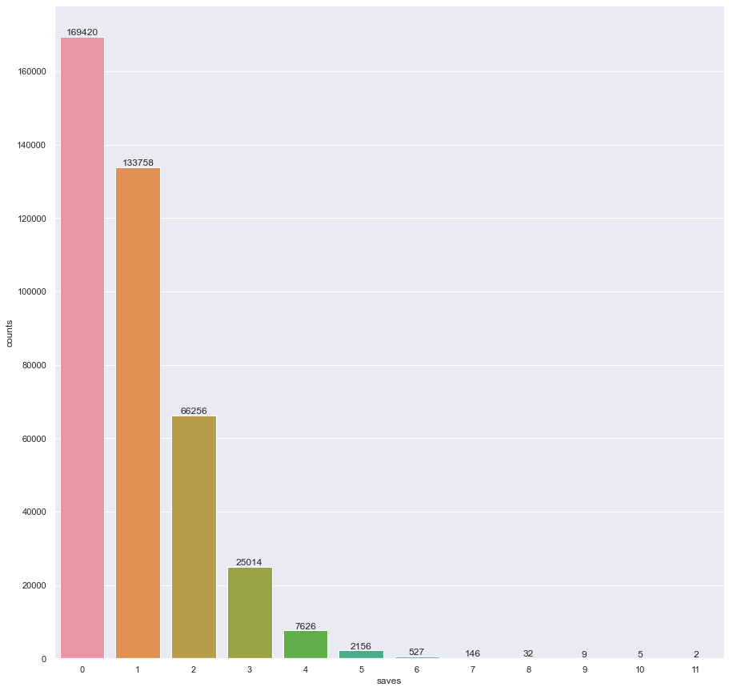
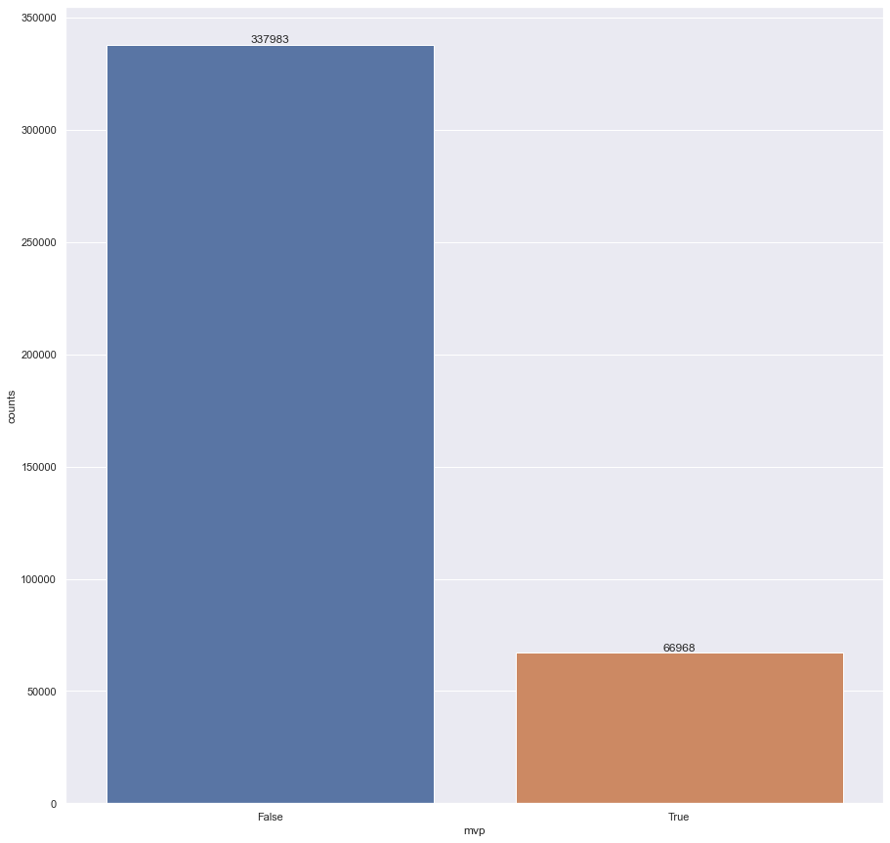
Data Understanding Data Exploration – Discrete / Categorial features

Slide 19
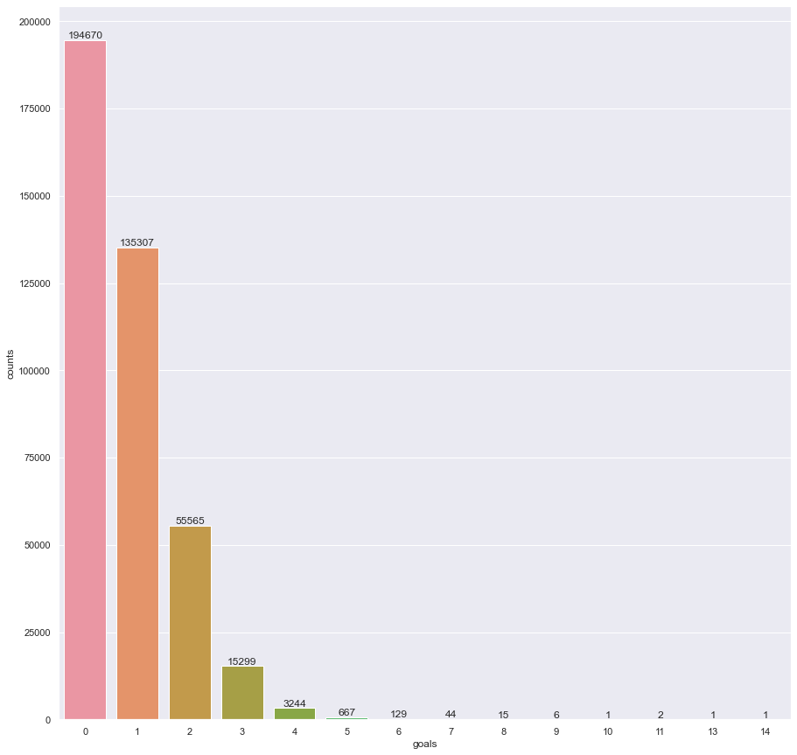
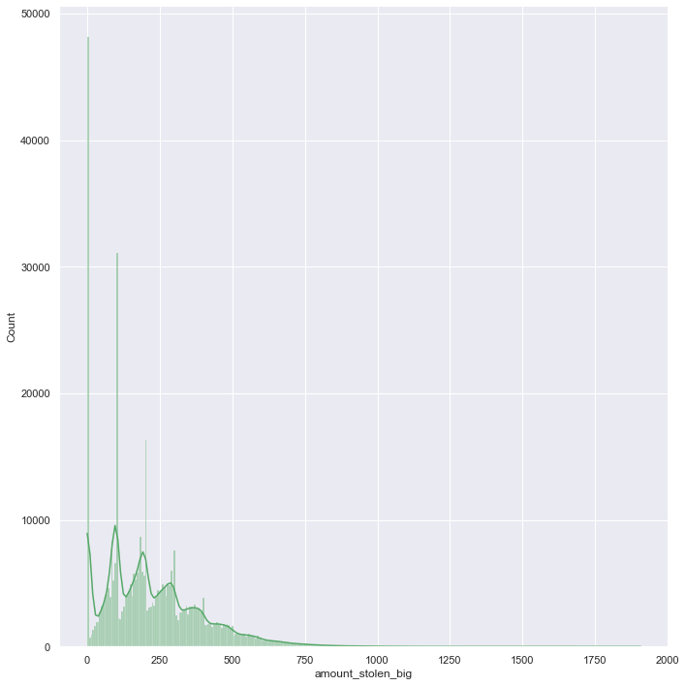
Data Understanding Data Exploration – Discrete features

Slide 20
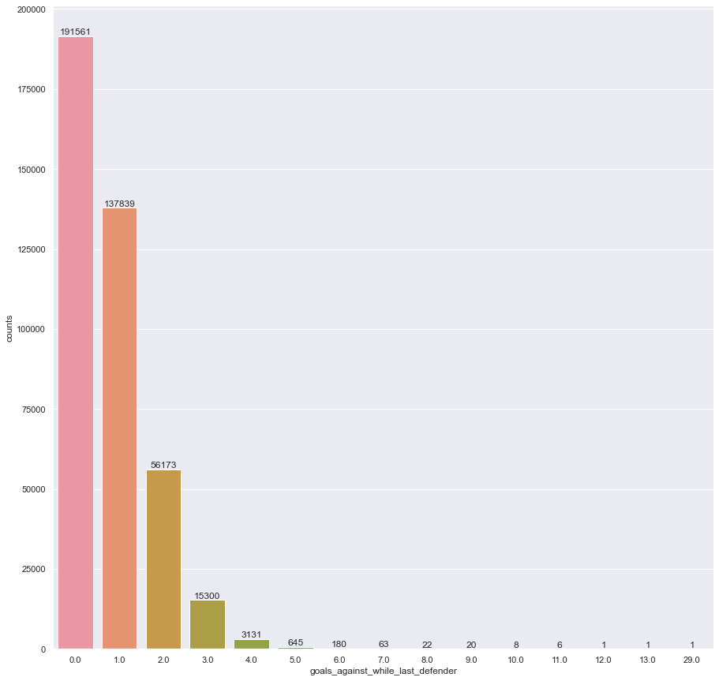
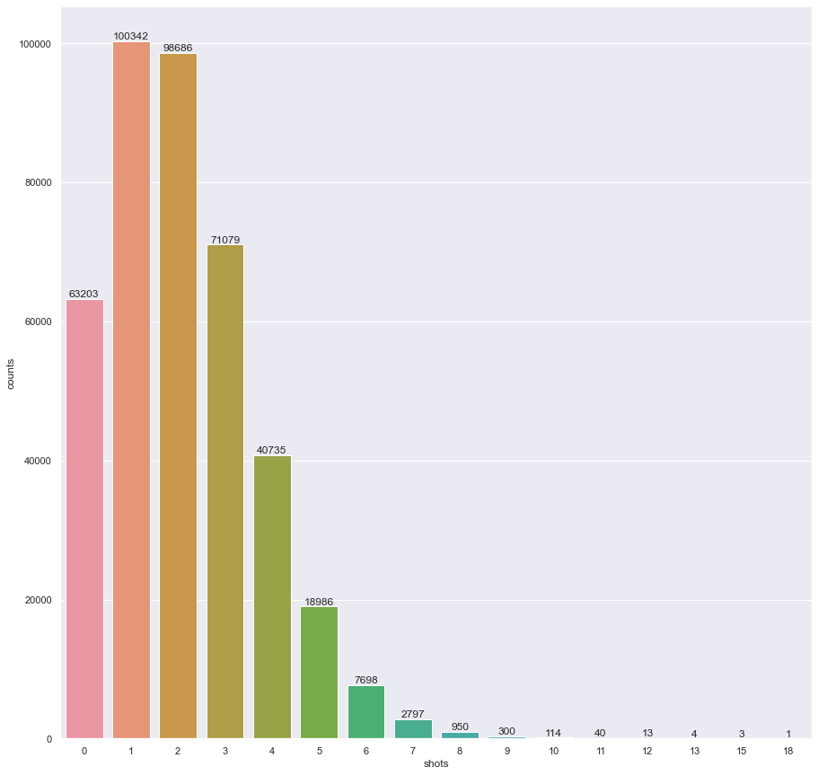
Data Understanding Data Exploration – Discrete features

Slide 21
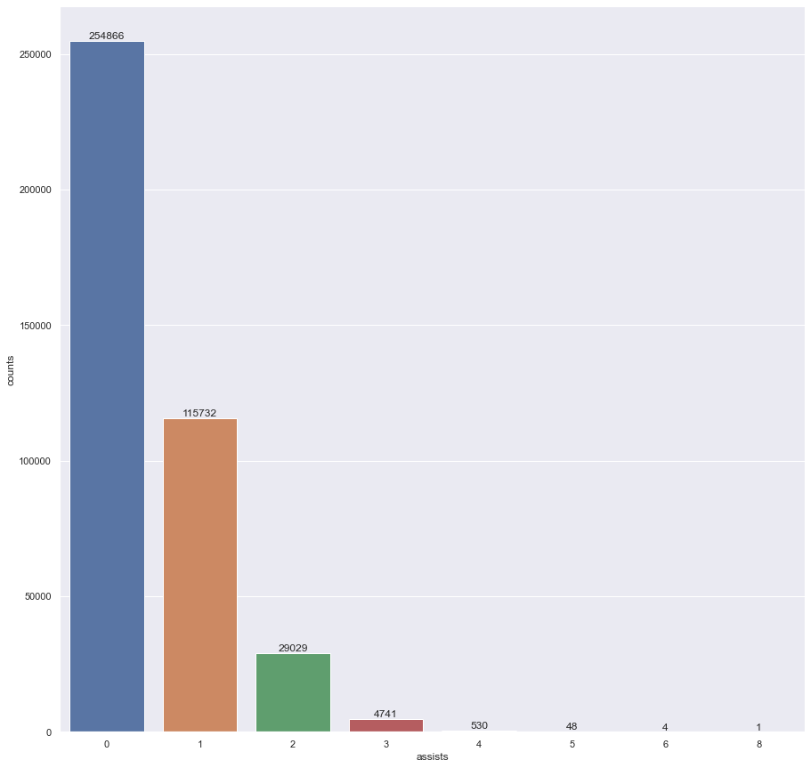
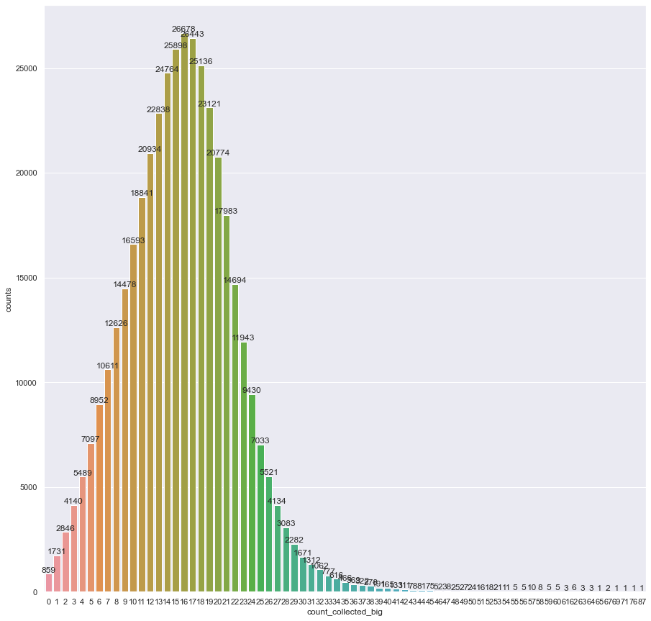
Data Understanding Data Exploration – Discrete features

Slide 22
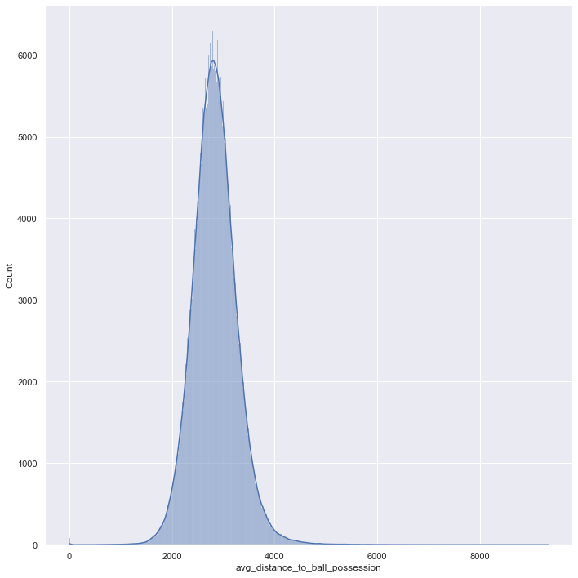
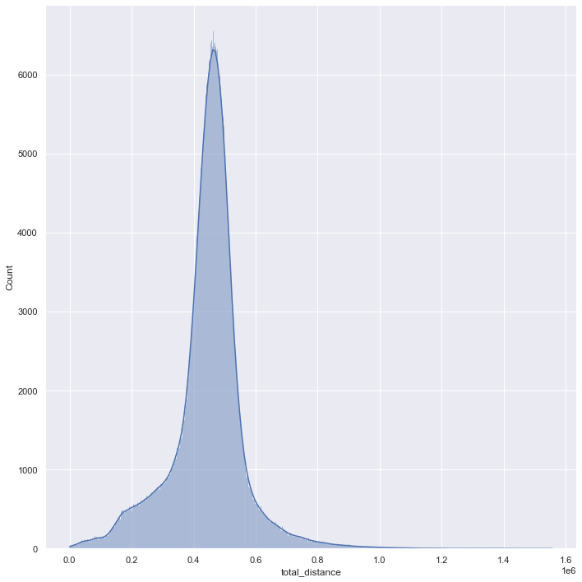
Data Understanding Data Exploration – Continuous features

Slide 23
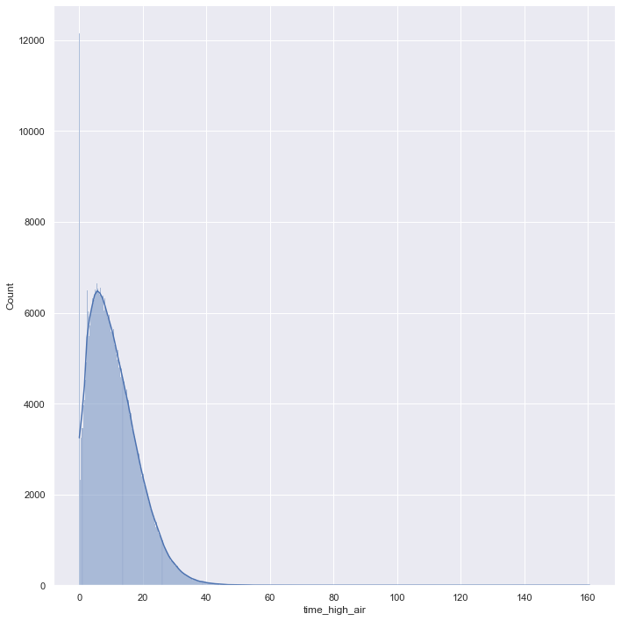
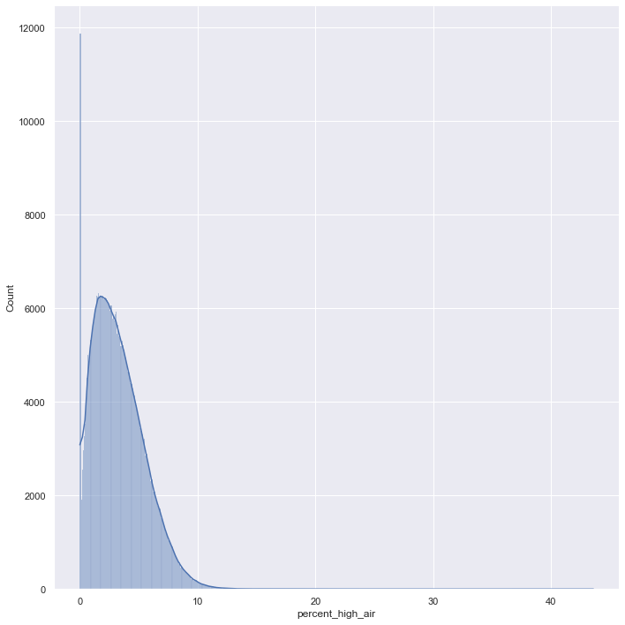
Data Understanding Data Exploration – Continuous features

Slide 24
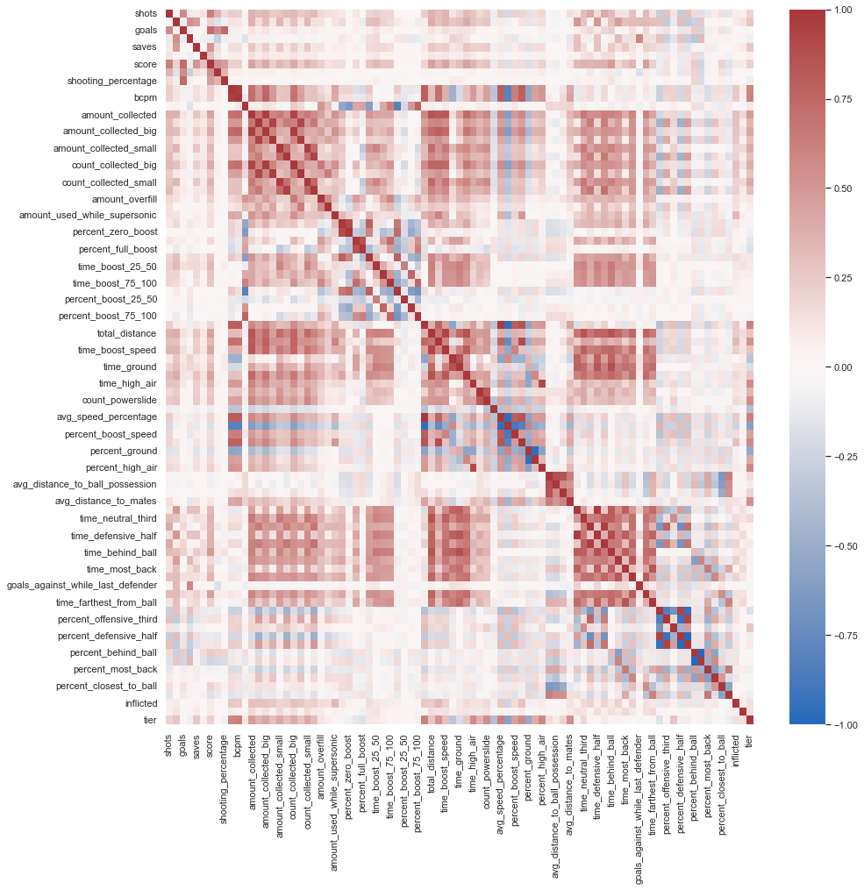
Data preparation Feature selection
A lot of correlated features
count/percentage
time/percentage
Boost collected / boost used
Etc.

Slide 25
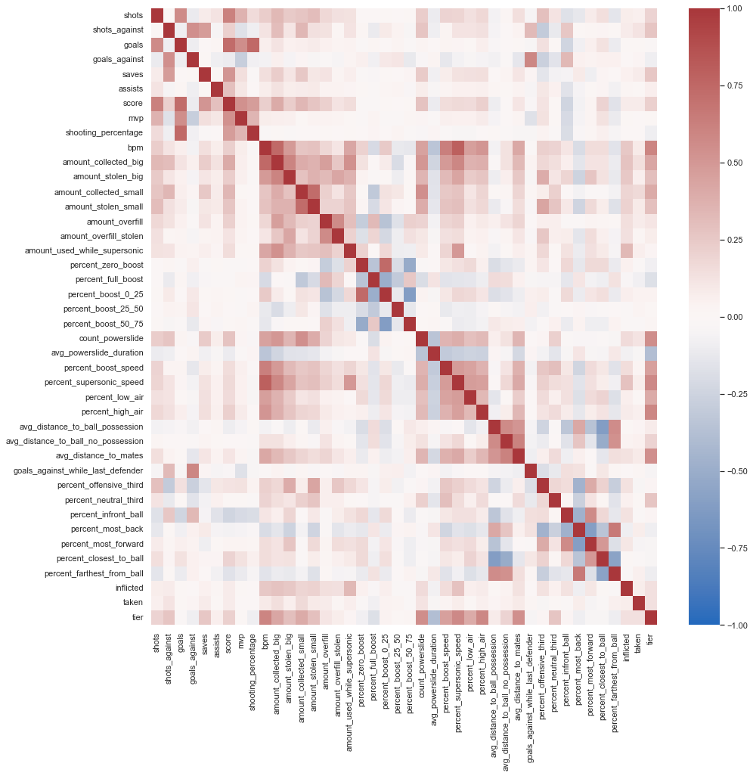
Data preparation Feature selection
From 84 features to 42

Slide 26
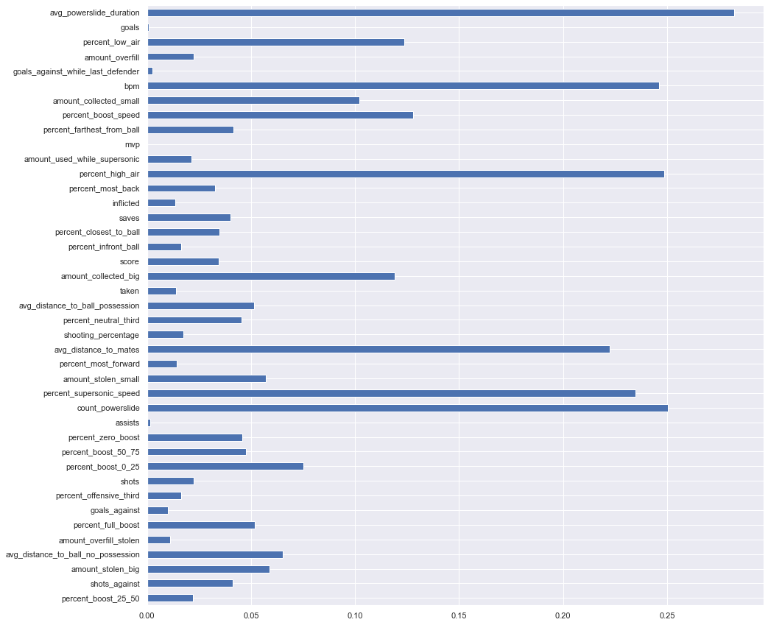
Data preparation Feature selection
Filter models
Information gain test

Slide 27
Data Preparation Feature selection
Insight give from the information gain test:
Remove match related features:
goals
mvp
assists
goals_against_while_last_defender
goals_against
Total 37 features

Slide 28
Data Preparation Construct data
Robust scaling, similar to z-score
but subtracts the median and
divides using the interquantile range between first and third quantile
Robust to outliers and more appropriated for skewed distributions
Percentages were simply divided by 100

Slide 29
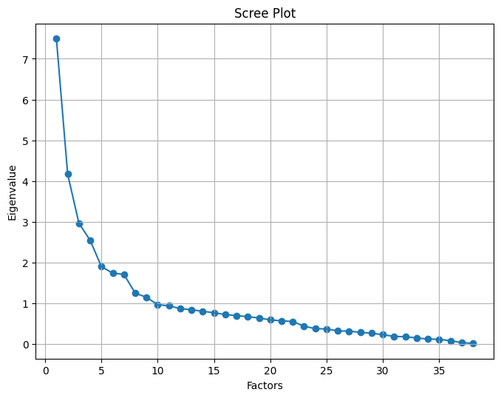
Data Preparation Factor analysis
Kaiser Criterion
9 eigenvalues above 1
10 factors chosen

Slide 30
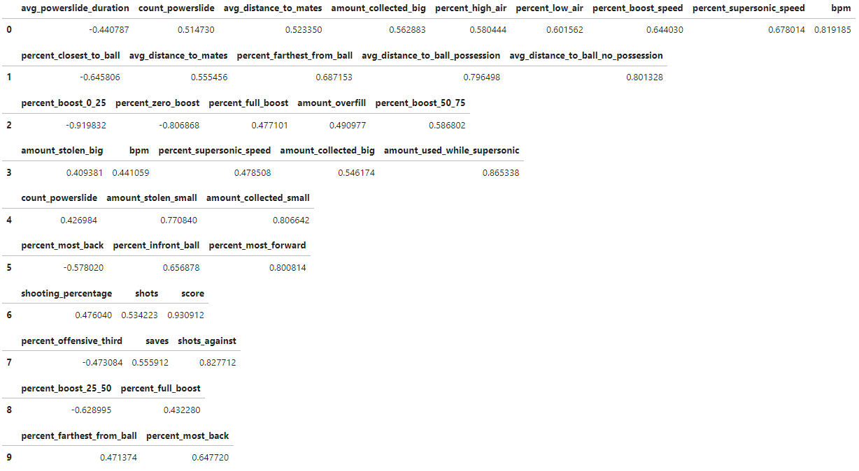
Factor loadings

Slide 31
Final datasets
Dataset preprocessed
Dataset factored
Stored as CSV files

Slide 32
Modeling
Propositional based methods chosen
Dummy regressor
Gaussian Naive Bayes
k-Nearest Neighbors
Random forest
XGBoost
Multi Layer Perceptron

Slide 33
Modeling Metrics
Root Mean Squared Error
Mean absolute Error

Slide 34
Modeling Evaluation technique
Holdout:
2/3 for training
1/3 for testing
Hyperparameters selection:
10 fold Cross Validation

Slide 35
Modeling Build models
Hyperparameters
Dummy regressor
Strategy: median, mean
Linear regressor
None
Gaussian Naive Bayes
Class priors: None, class frequencies
k-Nearest Neighbors
K = 3, 5
Random forest
Criterion: Poisson, Squared Error
N° estimators: 10, 100
XGBoost
Importance: weight, cover
N° estimators: 10, 100
Multi Layer Perceptron
Alpha = 1e-3, 1e-4, 1e-5
LR = 1e-3, 1e-2

Slide 36
Modeling Assess model

Slide 37
Evaluation Evaluate results
Business Analyst required
System achieved good results
Players are more satisfied with a ranking system that take in accounts their performances during the match
Conceivable to suppose that business objectives are satisfied

Slide 38
Evaluation Review process
MLP and Neural Networks could be more explored
Extract features directly from raw replays
Difficult to improve the obtained error
Information to discriminate player ranks could not be contained

Slide 39
Deployment and Maintenance
System can be implemented directly in the game servers
New MMR calculated with a weighted sum from the predictive model and the old system
Play-style changes over months, model need to be retrained periodically (2-3 months)

Slide 40




Grazie
Nome del relatore
Indirizzo di posta elettronica
Sito Web

Slide 41
Grafico

Slide 42
Tabella
 | Categoria 1 | Categoria 2 | Categoria 3 | Categoria 4
Elemento 1 | 4,5 | 2,3 | 1,7 | 5
Elemento 2 | 3,2 | 5,1 | 4,4 | 3
Elemento 3 | 2,1 | 1,7 | 2,5 | 2,8
Elemento 4 | 4,5 | 2,2 | 1,7 | 7

Slide 43
Team
Nome Titolo
Nome Titolo
Nome Titolo
Nome Titolo

